Slide 1
Backup and Recovery Concepts

Slide 2
Objectives
After completing this lesson, you should be able to:
  Identify the types of failure that can occur in an Oracle database
  Describe ways to tune instance recovery
  Identify the importance of checkpoints, redo log files, and archive log files
  Configure the fast recovery area
  Configure ARCHIVELOG mode
Notes:
Oracle Database 11g: Administration Workshop I 14 - <number>

Slide 3
Part of Your Job
The database administrator’s duties are to:
  Protect the database from failure wherever possible
  Increase the mean time between failures (MTBF)
  Protect critical components by redundancy
  Decrease the mean time to recover (MTTR)
  Minimize the loss of data
Notes:
Oracle Database 11g: Administration Workshop I 14 - <number>
Part of Your Job
The goal of the database administrator (DBA) is to ensure that the database is open and available when users need it. To achieve that goal, the DBA (working with the system administrator):
Anticipates and works to avoid common causes of failure
Works to increase the mean time between failures (MTBF) that negatively affect availability
Ensures that hardware is as reliable as possible, that critical components are protected by redundancy, and that operating system maintenance is performed in a timely manner. The Oracle database provides advanced configuration options to increase MTBF, including:
Real Application Clusters (discussed in the Oracle Database 11g: Real Application Clusters course)
Streams (discussed in the Oracle Database 11g: Implement Streams course)
Oracle Data Guard (discussed in the Oracle Database 11g: Data Guard Administration course)
Decreases the mean time to recover (MTTR) by practicing recovery procedures in advance and configuring backups so that they are readily available when needed

Slide 4
Notes:
Part of Your Job (continued)
Minimizes the loss of data. DBAs who follow accepted best practices can configure their databases so that no committed transaction is ever lost. Entities that assist in guaranteeing this include:
Archive log files (discussed later in this lesson)
Flashback technology
Standby databases and Oracle Data Guard (discussed in the Oracle Database 11g: Data Guard Administration course)

Slide 5


Categories of Failure
Failures can generally be divided into the following categories:
  Statement failure
  User process failure
  Network failure
  User error
  Instance failure
  Media failure
Notes:
Oracle Database 11g: Administration Workshop I 14 - <number>
Categories of Failure
Statement failure: A single database operation (select, insert, update, or delete) fails.
User process failure: A single database session fails.
Network failure: Connectivity to the database is lost.
User error: A user successfully completes an operation, but the operation (dropping a table or entering bad data) is incorrect.
Instance failure: The database instance shuts down unexpectedly.
Media failure: A loss of any file that is needed for database operation (that is, the files have been deleted or the disk has failed).

Slide 6
Statement Failure
Typical Problems | Possible Solutions
Attempts to enter invalid data into a table | Work with users to validate and correct data.
Attempts to perform operations with insufficient privileges | Provide appropriate object or system privileges.
Attempts to allocate space that fail | Enable resumable space allocation. Increase owner quota. Add space to tablespace.
Logic errors in applications | Work with developers to correct program errors.
Notes:
Oracle Database 11g: Administration Workshop I 14 - <number>
Statement Failure
When a single database operation fails, DBA involvement may be necessary to correct errors with user privileges or database space allocation. DBAs may also need to assist in trouble-shooting, even for problems that are not directly in their task area. This can vary greatly from one organization to another. For example, in organizations that use off-the-shelf applications (that is, organizations that have no software developers), the DBA is the only point of contact and must examine logic errors in applications.
To understand logic errors in applications, you should work with developers to understand the scope of the problem. Oracle Database tools may provide assistance by helping to examine audit trails or previous transactions.
Note: In many cases, statement failures are by design and desired. For example, security policies and quota rules are often decided upon in advance. When a user gets an error while trying to exceed his or her limits, it may be desired for the operation to fail and no resolution may be necessary.

Slide 7

User Process Failure
Typical Problems | Possible Solutions
A user performs an abnormal disconnect. A user’s session is abnormally terminated. A user experiences a program error that terminates the session. | A DBA’s action is not usually needed to resolve user process failures. Instance background processes roll back uncommitted changes and release locks. Watch for trends.
Notes:
Oracle Database 11g: Administration Workshop I 14 - <number>
User Process Failure
User processes that abnormally disconnect from the instance may have uncommitted work in progress that needs to be rolled back. The Process Monitor (PMON) background process periodically polls server processes to ensure that their sessions are still connected. If PMON finds a server process whose user is no longer connected, PMON recovers from any ongoing transactions; it also rolls back uncommitted changes and releases any locks that are held by the failed session.
A DBA’s intervention should not be required to recover from user process failure, but the administrator must watch for trends. One or two users disconnecting abnormally is not a cause for concern. A small percentage of user process failures may occur from time to time.
But consistent and systemic failures indicate other problems. A large percentage of abnormal disconnects may indicate a need for user training (which includes teaching users to log out rather than just terminate their programs). It may also be indicative of network or application problems.

Slide 8
Network Failure
Typical Problems | Possible Solutions
Listener fails. | Configure a backup listener and connect-time failover.
Network Interface Card (NIC) fails. | Configure multiple network cards.
Network connection fails. | Configure a backup network connection.
Notes:
Oracle Database 11g: Administration Workshop I 14 - <number>
Network Failure
The best solution to network failure is to provide redundant paths for network connections. Backup listeners, network connections, and network interface cards reduce the chance that network failures will affect system availability.

Slide 9

User Error
Typical Causes | Possible Solutions
User inadvertently deletes or modifies data. | Roll back transaction and dependent transactions or rewind table.
User drops a table. | Recover table from recycle bin.
Oracle LogMiner
Notes:
Oracle Database 11g: Administration Workshop I 14 - <number>
User Error
Users may inadvertently delete or modify data. If they have not yet committed or exited their program, they can simply roll back.
You can use Oracle LogMiner to query your online redo logs and archived redo logs through an Enterprise Manager or SQL interface. Transaction data may persist in online redo logs longer than it persists in undo segments; if you have configured archiving of redo information, redo persists until you delete the archived files. Oracle LogMiner is discussed in the Oracle Database Utilities reference.
Users who drop a table can recover it from the recycle bin by flashing back the table to before the drop. Flashback technologies are discussed in detail in the Oracle Database 11g: Administration Workshop II course.
If the recycle bin has already been purged, or if the user dropped the table with the PURGE option, the dropped table can still be recovered by using point-in-time recovery (PITR) if the database has been properly configured. PITR is discussed in the Oracle Database 11g: Administration Workshop II course and in the Oracle Database Backup and Recovery User’s Guide.

Slide 10



Flashback Technology
Using Flashback technology:
  Viewing past states of data
  Winding data back and forth in time
  Assisting users in error analysis and recovery
For error analysis:
Oracle Flashback Query
Oracle Flashback Versions Query
Oracle Flashback Transaction Query
For error recovery:
Oracle Flashback Transaction Backout
Oracle Flashback Table
Oracle Flashback Drop
Oracle Flashback Database
Notes:
Oracle Database 11g: Administration Workshop I 14 - <number>
Flashback Technology
The Oracle database provides Oracle Flashback technology: a group of features that support viewing past states of data—and winding data back and forth in time—without requiring restoring the database from backup. With this technology, you help users analyze and recover from errors. For users who have committed erroneous changes, use the following to analyze the errors:
Flashback Query: View committed data as it existed at some point in the past. The SELECT command with the AS OF clause references a time in the past through a time stamp or SCN.
Flashback Version Query: View committed historical data for a specific time interval. Use the VERSIONS BETWEEN clause of the SELECT command (for performance reasons with existing indexes).
Flashback Transaction Query: View all database changes made at the transaction level
Possible solutions to recover from user error:
Flashback Transaction Backout: Rolls back a specific transaction and dependent transactions
Flashback Table: Rewinds one or more tables to their contents at a previous time without affecting other database objects

Slide 11
Notes:
Flashback Technology (continued)
Flashback Drop: Reverses the effects of dropping a table by returning the dropped table from the recycle bin to the database along with dependent objects such as indexes and triggers
Flashback Database: Returns the database to a past time or system change number (SCN)

Slide 12
Instance Failure
Typical Causes | Possible Solutions
Power outage | Restart the instance by using the STARTUP command. Recovering from instance failure is automatic, including rolling forward changes in the redo logs and then rolling back any uncommitted transactions. Investigate the causes of failure by using the alert log, trace files, and Enterprise Manager.
Hardware failure
Failure of one of the critical background processes
Emergency shutdown procedures
Notes:
Oracle Database 11g: Administration Workshop I 14 - <number>
Instance Failure
Instance failure occurs when the database instance is shut down before synchronizing all database files. An instance failure can occur because of hardware or software failure or through the use of the emergency SHUTDOWN ABORT and STARTUP FORCE shutdown commands.
Administrator involvement in recovering from instance failure rarely required if Oracle Restart enabled and monitoring your database. Oracle Restart attempts to restart your database instance as soon as it fails. If manual intervention is required then there may be a more serious problem that prevents the instance from restarting, such as a memory CPU failure.

Slide 13
Understanding Instance Recovery:
Checkpoint (CKPT) Process
CKPT is responsible for:
  Updating data file headers with
  checkpoint information
  Updating control files with
  checkpoint information
  Signaling DBWn at
  full checkpoints
SGA
Database
buffer cache
DBWn
Database Writer
process
Control files
CKPT
Checkpoint process
Data files
Notes:
Oracle Database 11g: Administration Workshop I 14 - <number>
Understanding Instance Recovery: Checkpoint (CKPT) Process
To understand instance recovery, you need to understand the functioning of certain background processes.
Every three seconds (or more frequently), the CKPT process stores data in the control file to document the modified data blocks that DBWn has written from the SGA to disk. This is called an “incremental checkpoint.” The purpose of a checkpoint is to identify that place in the online redo log file where instance recovery is to begin (which is called the “checkpoint position”).
In the event of a log switch, the CKPT process also writes this checkpoint information to the headers of data files.
Checkpoints exist for the following reasons:
To ensure that modified data blocks in memory are written to the disk regularly so that data is not lost in case of a system or database failure
To reduce the time required for instance recovery (Only the online redo log file entries following the last checkpoint need to be processed for recovery.)
To ensure that all committed data has been written to data files during shutdown
The checkpoint information written by the CKPT process includes checkpoint position, system change number (SCN), location in the online redo log file to begin recovery, information about logs, and so on.
Note: The CKPT process does not write data blocks to the disk or redo blocks to the online redo log files.

Slide 14
Understanding Instance Recovery:
Redo Log Files and Log Writer
Redo log files:
  Record changes to the database
  Should be multiplexed to protect against loss
Log Writer writes:
  At commit
  When one-third full
  Every three seconds
  Before DBWn writes
  Before clean shutdowns
SGA
Redo log buffer
LGWR
Log Writer
Redo log
group 1
Redo log
group 2
Redo log
group 3
Notes:
Oracle Database 11g: Administration Workshop I 14 - <number>
Understanding Instance Recovery: Redo Log Files and Log Writer
Redo log files record changes to the database as a result of transactions and internal Oracle server actions. (A transaction is a logical unit of work consisting of one or more SQL statements run by a user.) Redo log files protect the database from the loss of integrity because of system failures caused by power outages, disk failures, and so on. Redo log files should be multiplexed to ensure that the information stored in them is not lost in the event of a disk failure.
The redo log consists of groups of redo log files. A group consists of a redo log file and its multiplexed copies. Each identical copy is said to be a member of that group, and each group is identified by a number. The Log Writer (LGWR) process writes redo records from the redo log buffer to all members of a redo log group until the files are filled or a log switch operation is requested.
It then switches and writes to the files in the next group. Redo log groups are used in a circular fashion.
Best practice tip: If possible, multiplexed redo log files should reside on different disks.

Slide 15
Understanding Instance Recovery
Automatic instance or crash recovery:
  Is caused by attempts to open a database whose files are not synchronized on shutdown
  Uses information stored in redo log groups to synchronize files
  Involves two distinct operations:
    Rolling forward: Redo log changes (both committed and uncommited) are applied to data files.
    Rolling back: Changes that are made but not committed are returned to their original state.
Notes:
Oracle Database 11g: Administration Workshop I 14 - <number>
Instance Recovery
The Oracle database automatically recovers from instance failure. All that needs to happen is for the instance to be started normally. If Oracle Restart is enabled and configured to monitor this database then this happens automatically. The instance mounts the control files and then attempts to open the data files. When it discovers that the data files have not been synchronized during shutdown, the instance uses information contained in the redo log groups to roll the data files forward to the time of shutdown. Then the database is opened and any uncommitted transactions are rolled back.

Slide 16
Phases of Instance Recovery
1. Startup instance (data files
are out of sync)
2. Roll forward (redo)
3. Committed and uncommitted data in files
4. Database opened
5. Roll back (undo)
6. Committed data in files
Instance
SGA
Background
processes
Database
SCN:
74-101
SCN:140
SCN:143
SCN:
102-143
SCN:129
SCN:143
Undo
SCN: 99
Control files
Redo log group
Data files
Notes:
Oracle Database 11g: Administration Workshop I 14 - <number>
Phases of Instance Recovery
For an instance to open a data file, the system change number (SCN) contained in the data file’s header must match the current SCN that is stored in the database’s control files.
If the numbers do not match, the instance applies redo data from the online redo logs, sequentially “redoing” transactions until the data files are up-to-date. After all data files have been synchronized with the control files, the database is opened and users can log in.
When redo logs are applied, all transactions are applied to bring the database up to the state as of the time of failure. This usually includes transactions that are in progress but have not yet been committed. After the database has been opened, those uncommitted transactions are rolled back.
At the end of the rollback phase of instance recovery, the data files contain only committed data.

Slide 17
Tuning Instance Recovery
  During instance recovery, the transactions between the checkpoint position and the end of redo log must be applied to data files.
  You tune instance recovery by controlling the difference between the checkpoint position and the end of redo log.
Checkpoint position
End of redo log
Instance recovery
Transactions
Notes:
Oracle Database 11g: Administration Workshop I 14 - <number>
Tuning Instance Recovery
Transaction information is recorded in the redo log groups before the instance returns commit complete for a transaction. The information in the redo log groups guarantees that the transaction can be recovered in case of a failure. The transaction information also needs to be written to the data file. The data file write usually happens at some time after the information is recorded in redo log groups because the data file write process is much slower than the redo writes. (Random writes for data files are slower than serial writes for redo log files.)
Every three seconds, the checkpoint process records information in the control file about the checkpoint position in the redo log. Therefore, the Oracle database knows that all redo log entries recorded before this point are not necessary for database recovery. In the graphic in the slide, the striped blocks have not yet been written to the disk.
The time required for instance recovery is the time required to bring data files from their last checkpoint to the latest SCN recorded in the control file. The administrator controls that time by setting an MTTR target (in seconds) and through the sizing of redo log groups. For example, for two redo groups, the distance between the checkpoint position and the end of the redo log group cannot be more than 90% of the smallest redo log group.

Slide 18
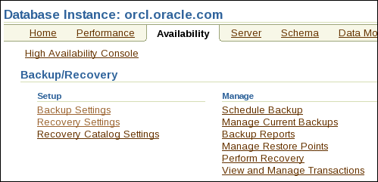
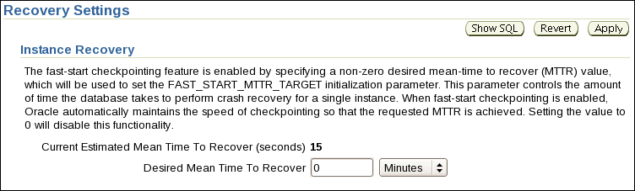
Using the MTTR Advisor
  Specify the desired time in seconds or minutes.
  The default value is 0 (disabled).
  The maximum value is 3,600 seconds (one hour).
Notes:
Oracle Database 11g: Administration Workshop I 14 - <number>
Using the MTTR Advisor
For assistance in setting the MTTR target, select either of the following:
Enterprise Manager > Advisor Central (in the Related Links section) > MTTR Advisor
Enterprise Manager > Availability > Recovery Settings
The FAST_START_MTTR_TARGET initialization parameter simplifies the configuration of recovery time from instance or system failure. The MTTR Advisor converts the FAST_START_MTTR_TARGET value into several parameters to enable instance recovery in the desired time (or as close to it as possible). Please note, explicitly setting the FAST_START_MTTR_TARGET parameter to 0 disables the MTTR advisor.
The FAST_START_MTTR_TARGET parameter must be set to a value that supports the service level agreement for your system. A small value for the MTTR target increases I/O overhead because of additional data file writes (affecting the performance). However, if you set the MTTR target too large, the instance takes longer to recover after a crash.

Slide 19
Media Failure
Typical Causes | Possible Solutions
Failure of disk drive | 1. Restore the affected file from backup. 2. Inform the database about a new file location (if necessary). 3. Recover the file by applying redo information (if necessary).
Failure of disk controller
Deletion or corruption of a file needed for database operation
Notes:
Oracle Database 11g: Administration Workshop I 14 - <number>
Media Failure
Oracle Corporation defines media failure as any failure that results in the loss or corruption of one or more database files (data, control, or redo log file).
Recovering from media failure requires that you restore and recover the missing files. To ensure that your database can be recovered from media failure, follow the best practices outlined in the next few pages.

Slide 20
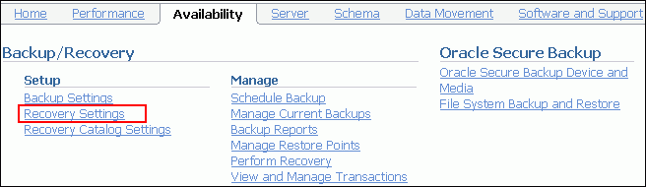
Configuring for Recoverability
To configure your database for maximum recoverability, you must:
  Schedule regular backups
  Multiplex control files
  Multiplex redo log groups
  Retain archived copies of redo logs
Notes:
Oracle Database 11g: Administration Workshop I 14 - <number>
Configuring for Recoverability
To provide the best protection for your data, you must:
Schedule regular backups
Most media failures require that you restore the lost or damaged file from backup.
Multiplex control files
All control files associated with a database are identical. Recovering from the loss of a single control file is not difficult; recovering from the loss of all control files is much more challenging. Guard against losing all control files by having at least two copies.
Multiplex redo log groups
To recover from instance or media failure, redo log information is used to roll data files forward to the last committed transaction. If your redo log groups rely on a single redo log file, the loss of that file means that data is likely to be lost. Ensure that there are at least two copies of each redo log group; if possible, each copy should be under different disk controllers.
Retain archived copies of redo logs
If a file is lost and restored from backup, the instance must apply redo information to bring that file up to the latest SCN contained in the control file. With the default setting, the database can overwrite redo information after it has been written to the data files. Your database can be configured to retain redo information in archived copies of the redo logs. This is known as placing the database in ARCHIVELOG mode.
You can perform configuration tasks in Enterprise Manager or with the command line.

Slide 21
Configuring the Fast Recovery Area
Fast recovery area:
  Strongly recommended for simplified backup storage management
  Storage space (separate from working database files)
  Location specified by the DB_RECOVERY_FILE_DEST parameter
  Size specified by the DB_RECOVERY_FILE_DEST_SIZE parameter
  Large enough for backups, archived logs, flashback logs, multiplexed control files, and multiplexed redo logs
  Automatically managed according to your retention policy
Configuring the fast recovery area means determining location, size, and retention policy.
Notes:
Configuring the Fast Recovery Area
The fast recovery area is a space that is set aside on the disk to contain archived logs, backups, flashback logs, multiplexed control files, and multiplexed redo logs. A fast recovery area simplifies backup storage management and is strongly recommended. You should place the fast recovery area on storage space that is separate from the location of your database data files and primary online log files and control file.
The amount of disk space to allocate for the fast recovery area depends on the size and activity levels of your database. As a general rule, the larger the fast recovery area, the more useful it is. Ideally, the fast recovery area should be large enough for copies of your data and control files and for flashback, online redo, and archived logs needed to recover the database with the backups kept based on the retention policy. (In short, the fast recovery area should be at least twice the size of the database so that it can hold one backup and several archived logs.)
Space management in the fast recovery area is governed by a backup retention policy. A retention policy determines when files are obsolete, which means that they are no longer needed to meet your data recovery objectives. The Oracle database automatically manages this storage by deleting files that are no longer needed.

Slide 22
Multiplexing Control Files
To protect against database failure, your database should have multiple copies of the control file.
 | ASM Storage | File System Storage
Best Practice | One copy on each disk group (such as +DATA and +FRA) | At least two copies, each on separate disk (at least one on separate disk controller)
Steps to create additional control files | No additional control file copies required. | 1. Alter the SPFILE with the ALTER SYSTEM SET control_files command. 2. Shut down the database. 3. Copy control file to a new location. 4. Open the database and verify the addition of the new control file.
Notes:
Oracle Database 11g: Administration Workshop I 14 - <number>
Multiplexing Control Files
A control file is a small binary file that describes the structure of the database. It must be available for writing by the Oracle server whenever the database is mounted or opened. Without this file, the database cannot be mounted, and recovery or re-creation of the control file is required. Your database should have a minimum of two control files on different storage devices to minimize the impact of a loss of one control file.
The loss of a single control file causes the instance to fail because all control files must be available at all times. However, recovery can be a simple matter of copying one of the other control files. The loss of all control files is slightly more difficult to recover from but is not usually catastrophic.

Slide 23
Notes:
Multiplexing Control Files (continued)
Adding a Control File
If using ASM as your storage technique, then as long as you have two control files, one in each disk group (such as +DATA and +FRA), then you should not require further multiplexing. In a database using OMF (such as a database using ASM storage), all additional control files must be created as part of a recovery process using RMAN (or through Enterprise Manager). In a database using regular file system storage, adding a control file is a manual operation:
1. Alter the SPFILE with the following command:
ALTER SYSTEM SET control_files =
'/u01/app/oracle/oradata/orcl/control01.ctl' ,
'/u02/app/oracle/oradata/orcl/control02.ctl' ,
'/u03/app/oracle/oradata/orcl/control03.ctl' SCOPE=SPFILE;
2. Shut down the database.
3. Use the operating system to copy an existing control file to the location you select for your new file.
4. Open the database.
Note: More information on using RMAN is covered in the course titled Oracle Database 11g: Administration Workshop II and online product documentation.

Slide 24
Redo Log Files
Multiplex redo log groups to protect against media failure and loss of data. This increases database I/O. It is suggested that redo log groups have:
  At least two members (files) per group
  Each member:
    On a separate disk or
    controller if using
    file system storage
    In a separate disk group
    (such as +DATA and +FRA)
    if using ASM
+DATA
Member a
Member a
Member a
+FRA
Member b
Member b
Member b
Group 1
Group 2
Group 3
Note: Multiplexing redo logs may impact overall database performance.
Notes:
Oracle Database 11g: Administration Workshop I 14 - <number>
Redo Log Files
Redo log groups are made up of one or more redo log files. Each log file in a group is a duplicate of the others. Oracle Corporation recommends that redo log groups have at least two files per group. If using file system storage, then each member should be distributed on separate disks or controllers so that no single equipment failure destroys an entire log group. If using ASM storage, then each member should be in a separate disk group, such as +DATA and +FRA.
The loss of an entire current log group is one of the most serious media failures because it can result in loss of data. The loss of a single member of a multiple-member log group is trivial and does not affect database operation (other than causing an alert to be published in the alert log). Recovery from the loss of an entire log group requires advanced recovery techniques and is discussed in the course titled Oracle Database 11g: Administration Workshop II.
Remember that multiplexing redo logs may heavily influence database performance because a commit cannot complete until the transaction information has been written to the logs. You must place your redo log files on your fastest disks served by your fastest controllers. If possible, do not place any other database files on the same disks as your redo log files (unless you are using Automatic Storage Management [ASM]). Because only one group is written to at a given time, there is no performance impact in having members from several groups on the same disk.

Slide 25
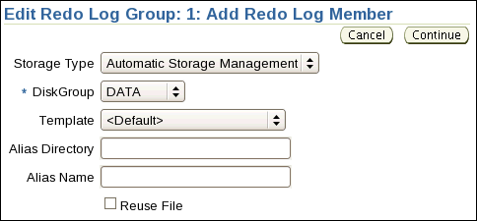
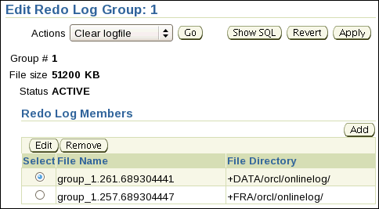
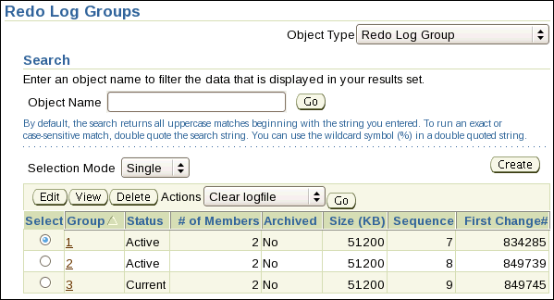
Multiplexing the Redo Log
If Storage Type is File System, then you are prompted to enter a File Name and File Directory.
Notes:
Oracle Database 11g: Administration Workshop I 14 - <number>
Multiplexing the Redo Log
You can multiplex your redo log by adding a member to an existing log group. To add a member to a redo log group (with open database and no impact on user performance), perform the following steps:
1. Select Enterprise Manager > Server > Redo Log Groups.
2. Select a group and click the Edit button, or click the group number link.
The Edit Redo Log Group page appears.
3. In the Redo Log Members region, click Add.
The Add Redo Log Member page appears.
4. Choose the appropriate Storage Type, and enter the required information. For ASM, choose the disk group and, if desired, specify template and alias information. For File System storage, enter the file name and the file directory. Click Continue.
Repeat these steps for every existing group that you want to multiplex. An example showing the SQL syntax of adding a redo log member to redo log group 1 (using ASM) is shown here:
SQL> ALTER DATABASE ADD LOGFILE MEMBER '+DATA' TO GROUP 1;
When you add the redo log member to a group, the member’s status is marked as INVALID (as can be seen in the V$LOGFILE view). This is the expected state because the new member of the group has not yet been written to. When a log switch occurs and the group containing the new member becomes CURRENT, the member’s status changes to null.

Slide 26

Archive Log Files
To preserve redo information, create archived copies of redo log files by performing the following steps.
  1. Specify archive log file-naming convention.
  2. Specify one or more archive log file locations.
  3. Switch the database to ARCHIVELOG mode.
Online redo log files
Archive log files
Notes:
Oracle Database 11g: Administration Workshop I 14 - <number>
Archive Log Files
The instance treats the online redo log groups as a circular buffer in which to store transaction information, filling one group and then moving on to the next. After all groups have been written to, the instance begins overwriting information in the first log group.
To configure your database for maximum recoverability, you must instruct the database to make a copy of the online redo log group before allowing it to be overwritten. These copies are known as archived logs.
To facilitate the creation of archive log files:
1. Specify a naming convention for your archive logs.
2. Specify a destination or destinations for storing your archive logs. One of the destinations is probably your fast recovery area.
3. Place the database in ARCHIVELOG mode.
Note: Steps 1 and 2 are not necessary if you are using a fast recovery area.
The destination should exist before placing the database in ARCHIVELOG mode. When a directory is specified as a destination, there should be a slash at the end of the directory name.

Slide 27
Archiver (ARCn) Process
Archiver (ARCn):
  Is an optional background process
  Automatically archives online redo log files when ARCHIVELOG mode is set for the database
  Preserves the record of all changes made to the database
SGA
Redo log buffer
LGWR
Log Writer
Copies of Redo log
files
Redo log
files
ARCn
Archiver process
Notes:
Oracle Database 11g: Administration Workshop I 14 - <number>
The Archiver (ARCn) Process
ARCn is an optional background process. However, it is crucial to the recovery of a database after the loss of a disk. When an online redo log group gets filled, the Oracle instance begins writing to the next online redo log group. The process of switching from one online redo log group to another is called a log switch. The ARCn process initiates archiving of the filled log group at every log switch. It automatically archives the online redo log group before the log group can be reused so that all the changes made to the database are preserved. This enables recovery of the database to the point of failure even if a disk drive is damaged.
One of the important decisions that a DBA must make is whether to configure the database to operate in ARCHIVELOG mode or in NOARCHIVELOG mode.
In NOARCHIVELOG mode, the online redo log files are overwritten each time a log switch occurs.
In ARCHIVELOG mode, inactive groups of filled online redo log files must be archived before they can be used again.
Note
ARCHIVELOG mode is essential for most backup strategies (and is very easy to configure).
If the Archive log file destination fills up or cannot be written, the database will eventually come to a halt. Remove archive files from the archive log file destination and the database will resume operations.

Slide 28
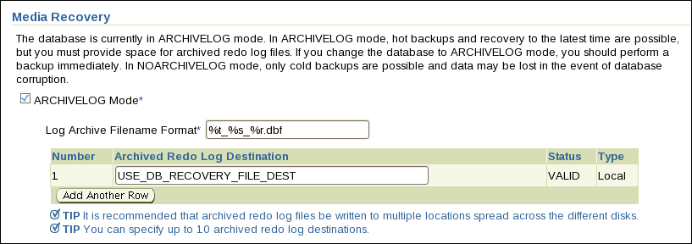
Archive Log File: Naming and Destinations
Specify naming and archive destination information on the Recovery Settings page. If using file system storage then it is recommended that you add multiple locations across different disks.
Notes:
Oracle Database 11g: Administration Workshop I 14 - <number>
Archive Log File: Naming and Destinations
To configure archive log file names and destinations, select Enterprise Manager > Availability > Configure Recovery Settings.
Each archive log file must have a unique name to avoid overwriting older log files. Specify the naming format as shown in the slide. To help create unique file names, Oracle Database 11g allows several wildcard characters in the name format:
%s: Includes the log sequence number as part of the file name
%t: Includes the thread number as part of the file name
%r: Includes the resetlogs ID to ensure that the archive log file name remains unique (even after
certain advanced recovery techniques that reset log sequence numbers)
%d: Includes the database ID as part of the file name
The format should include %s, %t, and %r as best practice (%d can also be included if multiple databases share the same archive log destination).
By default if the fast recovery area is enabled, then USE_DB_RECOVERY_FILE_DEST is specified as an archive log file destination. Archive log files can be written to as many as ten different destinations. Destinations may be local (a directory) or remote (an Oracle Net alias for a standby database). Click Add Another Row to add further destinations. To change recovery settings, you must be connected as SYSDBA or SYSOPER.
Note: If you do not want archives sent to this location, delete USE_DB_RECOVERY_FILE_DEST.

Slide 29
Enabling ARCHIVELOG Mode
To place the database in ARCHIVELOG mode, perform the following steps in Enterprise Manager:
  1. Select the ARCHIVELOG Mode check box and click Apply.
  The database can be set to ARCHIVELOG mode only from the MOUNT state.
  2. Restart the database (with SYSDBA privileges).
  3. (Optional) View the archive status.
  4. Back up your database.
Note: Databases in ARCHIVELOG
mode have access to the full
range of backup and recovery
options.
sqlplus / as sysdba
shutdown immediate
startup mount
alter database archivelog;
alter database open;
archive log list
Notes:
Oracle Database 11g: Administration Workshop I 14 - <number>
Enabling ARCHIVELOG Mode
1. In Enterprise Manager, select Availability > Configure Recovery Settings > ARCHIVELOG Mode. The equivalent SQL command is:
SQL> ALTER DATABASE ARCHIVELOG;
This command can be issued only while the database is in the MOUNT state. The instance must therefore be restarted to complete this last step.
2. In Enterprise Manager, you are prompted for operating system and database credentials during the restart of the database. The database credentials must be for a user with the SYSDBA privileges.
3. After the instance is restarted, the changes that you have made to the archive processes, log format, and log destinations are in effect. In SQL*Plus, you can see them with the ARCHIVE LOG LIST command.
4. Back up your database after switching to ARCHIVELOG mode because your database is only recoverable from the last backup taken in that mode.
With the database in NOARCHIVELOG mode (the default), recovery is possible only until the time of the last backup. All transactions made after that backup are lost.
In ARCHIVELOG mode, recovery is possible until the time of the last commit. Most production databases are run in ARCHIVELOG mode.

Slide 30
Quiz
Statement failure is never by design and always requires the DBA to address the issue.
  True
  False
Notes:
Answer: 2

Slide 31
Quiz
Which parameters configure the fast recovery area?
  FLASH_RECOVERY_AREA_SIZE
  DB_RECOVERY_FILE_DEST
  FLASH_RECOVERY_AREA_LOC
  DB_RECOVERY_FILE_DEST_SIZE
Notes:
Answers: 2, 4

Slide 32
Summary
In this lesson, you should have learned how to:
  Identify the types of failure that can occur in an Oracle database
  Describe ways to tune instance recovery
  Identify the importance of checkpoints, redo log files, and archive log files
  Configure the fast recovery area
  Configure ARCHIVELOG mode
Notes:
Oracle Database 11g: Administration Workshop I 14 - <number>

Slide 33
Practice 14 Overview:
Configuring for Recoverability
This practice covers the following topics:
  Verifying control files
  Configuring a default fast recovery area
  Multiplexing redo log groups
  Placing your database in ARCHIVELOG mode
  Ensuring that redundant archive logs are created
Notes:
Oracle Database 11g: Administration Workshop I 14 - <number>

